Slide 1
sharing code
Brady

Slide 2
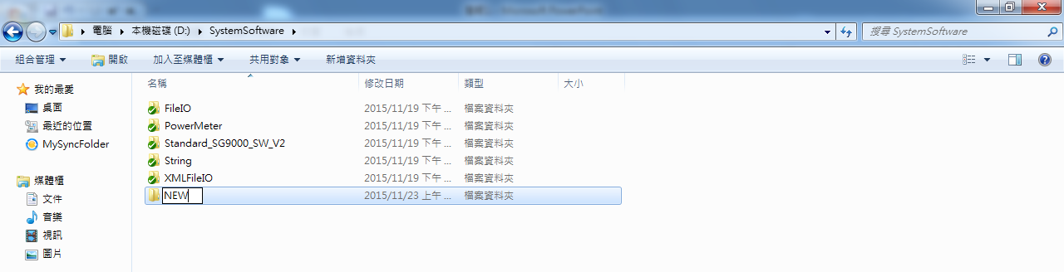
Download files
Install the tortoisehg
\\nts-file-rf\RD\OS_Software\TortoiseHg
Create a new folder as the target of download.

Slide 3
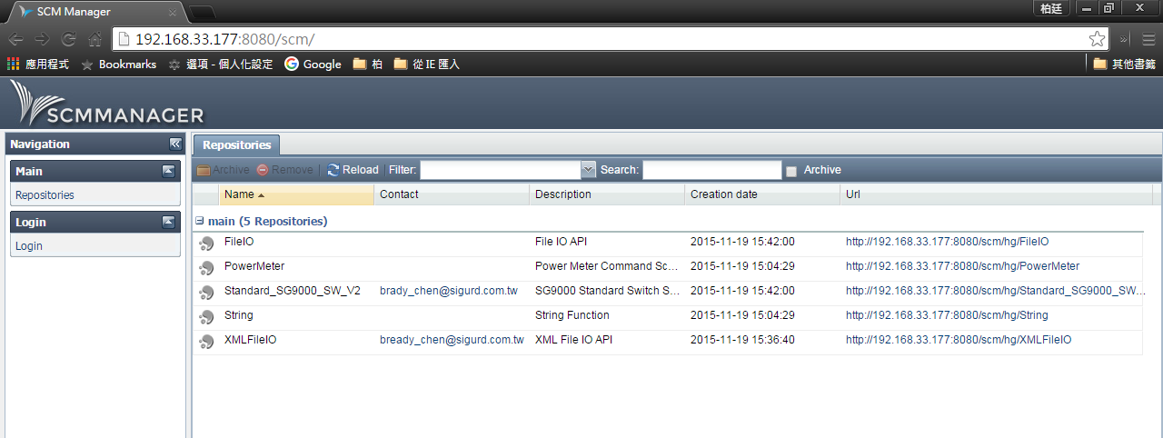
Download files
Enter the file server from your web browser
(http://192.168.33.177:8080/scm/)

Slide 4
Download files
Click the link of library listed at the “Url” field.

Slide 5
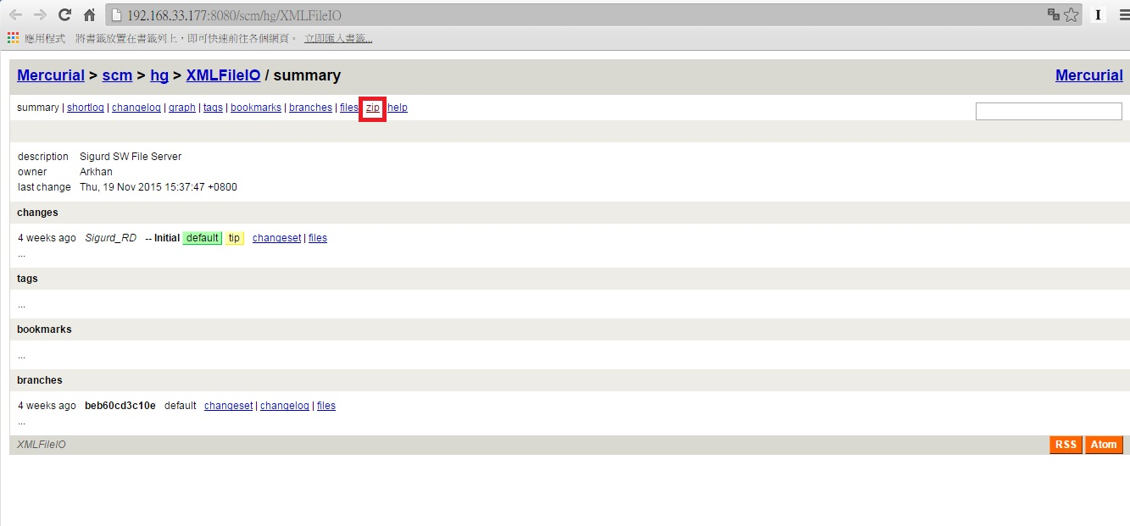
Download files
Click the “Zip” link to download the zip achive file.

